Slide 1
Title: Stack Overflow Developer Survey Analysis
Subtitle:
Ashish Singh Kaurav
Date-03/03/2026

Slide 2
Outline
Executive Summary
Introduction
Methodology
Programming Language Trends
Database Trends
Job Market Analysis
Dashboard Insights
Overall Findings
Conclusion

Slide 3
Executive Summary
JavaScript, HTML/CSS and C# dominate current usage.
PostgreSQL is the most popular and most desired database.
AWS and Azure lead cloud platform usage.
Mid-career professionals (30-45) earn highest median compensation.
Job satisfaction peaks at level 8
Strong correlation between experience and compensation.

Slide 4
Introduction
The purpose of this analysis is to understand the global developer landscape.
This dataset contains responses from thousands of developers across different countries, age groups, and employment types.
This analysis helps:
Which technologies are trending?
What skills should developers learn?
How does compensation vary?
What affects job satisfaction?
This analysis is useful for:
Hiring managers planning recruitment.
Developers planning career growth.
Organizations planning tech investments.

Slide 5
Methodology
Data Source:
Stack Overflow Developer Survey Dataset
Data Cleaning Steps Performed:
Removed missing values
Imputed numerical columns using median
Imputed categorical columns using mode
Removed compensation outliers (IQR method)
Converted Age and YearsCodePro to numeric
Created age groups
Log transformed compensation
Tools Used:
Python(Pandas, Numpy, Matplotlib, Seaborn)

Slide 6
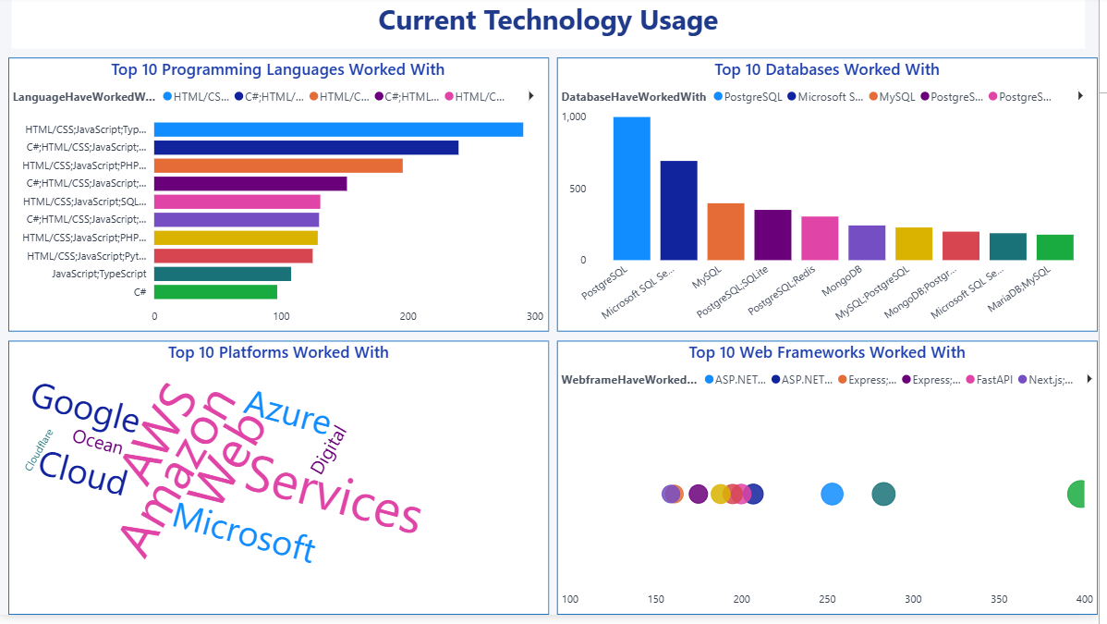
Current Programming Language Trends
In this analysis, I examined the most commonly used programming languages among developers.
JavaScript ranks highest.
HTML/CSS closely follows.
C#, Python, and TypeScript show strong adoption.
Multi-language usage is common.
JavaScript’s dominance confirms that web development continues to lead the global software market.
TypeScript’s strong position suggests a shift toward scalable and maintainable front-end development.
Python’s presence indicates its importance in data science, automation, and AI.

Slide 7
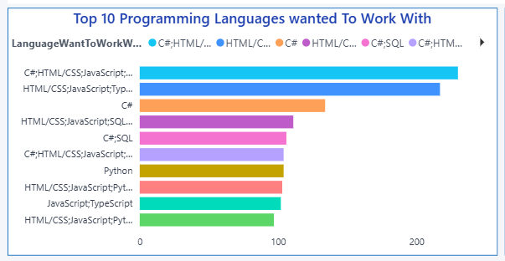
Future Programming Language Trends
This chart highlights the technologies developers are interested in learning next year.
Insights:
JavaScript remains strong.
Python interest is growing.
TypeScript continues to rise.
Modern ecosystems dominate preferences.
There is strong overlap between current usage and future interest, indicating stability in core technologies.
However, emerging languages show increased curiosity, suggesting innovation-driven learning.

Slide 8
Current Database Trends
This chart analyzes the most commonly used databases.
Observations:
PostgreSQL leads.
MySQL and SQL Server remain widely used.
MongoDB represents NoSQL adoption.
Redis show caching and performance focus.
PostgreSQL is a safe long-term skill investment.
Organizations still rely heavily on structured relational systems.

Slide 9
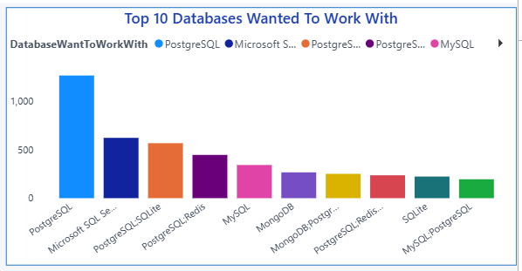
Future Database Demand
This chart reflects developer interest in future database technologies.
Insights:
PostgreSQL maintains top position.
Redis demand increasing.
MongoDB interest rising.
Traditional SQL databases still stable.
PostgreSQL appears in both current and future charts, indicating sustained dominance.
This suggests market maturity rather than rapid disruption.

Slide 10
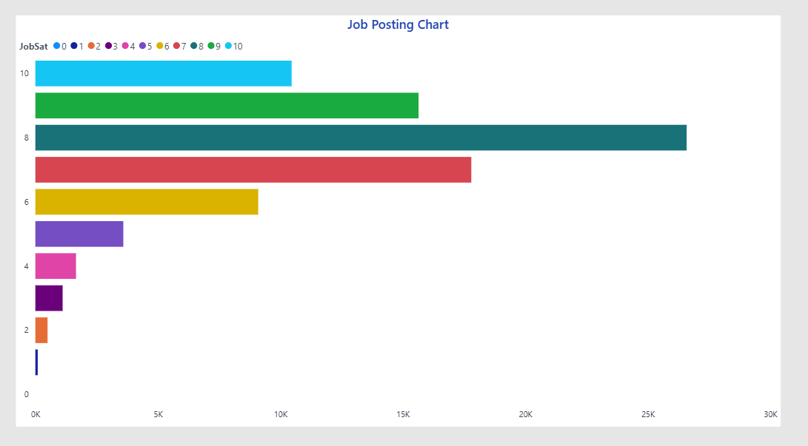
Job Satisfaction/ Market Distribution
This chart represents the distribution of job satisfaction levels among respondents.
Observations:
Satisfaction level 8 is most frequent.
Very low satisfaction levels are limited.
Majority fall between 6-8 range.
The developer workforce appears moderately to highly satisfied overall.
Extreme dissatisfaction is rare, which indicates relatively stable working conditions in tech.

Slide 11
Dashboard 1: Current Technology Usage

Slide 12
Current Technology Usage
This dashboard consolidates the current technology ecosystem across programming languages, databases, and platforms.
Highlights:
JavaScript dominates language usage.
PostgreSQL leads database adoption.
AWS is the most widely used cloud platform.
Full-time employment dominates respondents.
The ecosystem strongly revolves around web-first, cloud-integrated architectures.
This suggests that modern development is centered around scalable web applications.
Organizations must prioritize cloud-native development.
Hiring demand will continue in JavaScript & PostgreSQL stacks.

Slide 13
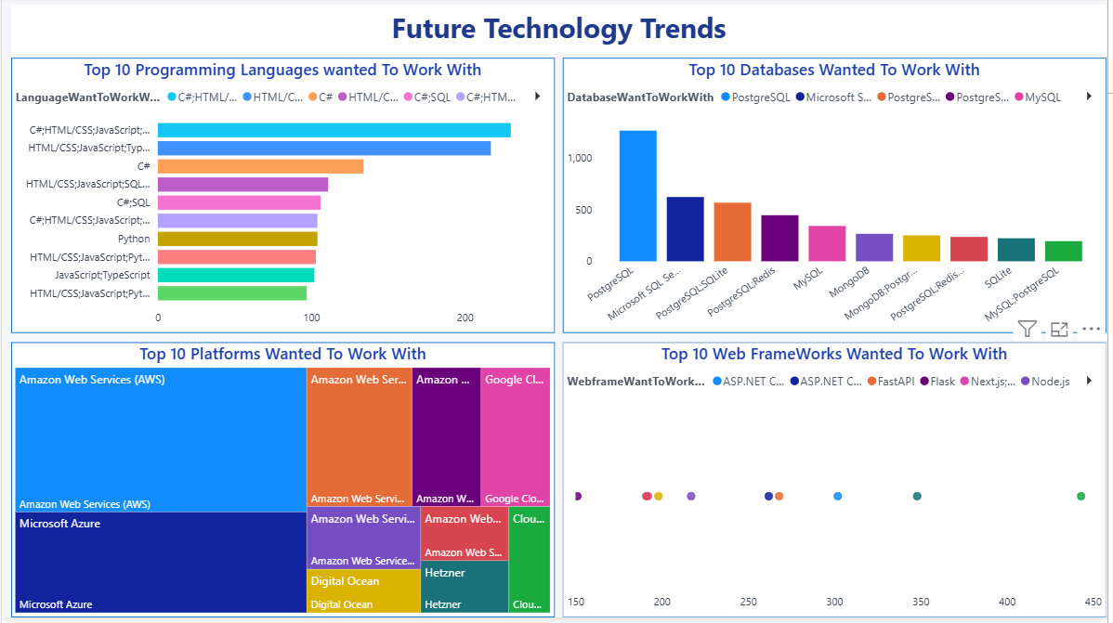
Dashboard 2: Future Technology Trends

Slide 14
Future Technology Trends
This dashboard captures technologies developers want to work with in the future.
Observations:
PostgreSQL remains dominant.
Redis and MongoDB interest increasing.
TypeScript and Python gaining traction.
Cloud platforms maintain strong demand.
There is strong overlap between current usage and future preference, indicating market stability.
At the same time, growing interest in modern tools suggests gradual innovation.
Organizations adopting trending technologies will attract talent.
Developers aligning with future-demand stacks improve career growth.

Slide 15
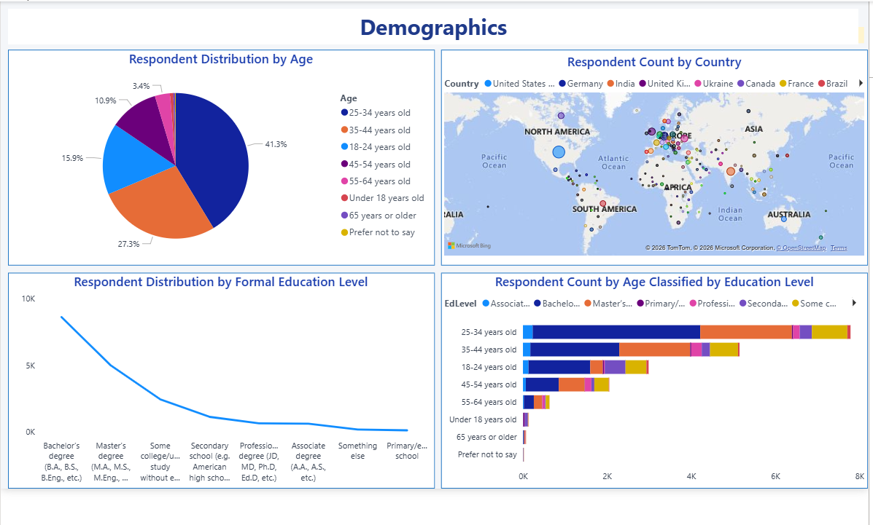
Dashboard 3: Demographics

Slide 16
Demographics
This dashboard summarizes age distribution, education level, and employment type.
Insights:
Majority age group 25-34.
Most developers hold Bachelor’s degrees.
Full-time employment dominates.
USA, India, Germany among top respondent countries.
The global tech workforce is young, educated, and largely employed in stable roles.

Slide 17
Overall Business Conclusion
This analysis reveals a stable yet evolving developer ecosystem characterized by:
Dominance of web and cloud technologies
Strong compensation growth with experience
High employability across regions
Moderate to high job satisfaction levels
Technology markets show incremental innovation rather than disruptive shifts.
For Companies:
Invest in cloud-native architecture.
Focus on PostgreSQL and modern web stacks.
Create mid-career growth paths.
Offer continuous learning programs.
For Developers:
Build expertise in JavaScript ecosystem.
Learn PostgreSQL and cloud integration.
Gain 5-10 years of focused experience for strong salary growth.
Develop multi skill capability.

Slide 18
Project Conclusion
The Stack Overflow Developer Survey data provides valuable insights into global developer trends.
Organizations that invest in cloud technologies, modern databases, and continuous talent development will remain competitive.
For developers, focusing on high-demand stacks and accumulating professional experience significantly improves earning potential.

